Slide 1
Year 11 biology revision
Paper 1

Slide 2
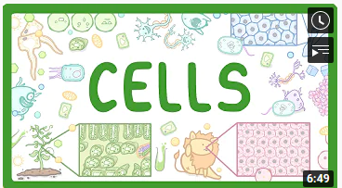
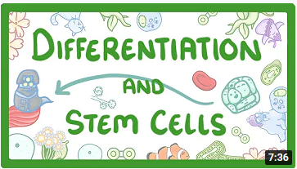
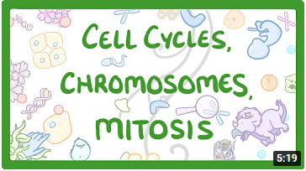
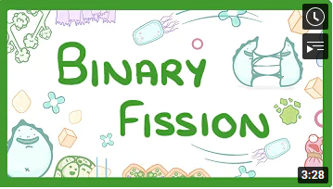
GCSE Biology - Cell Types and Cell Structure #1 - YouTube
GCSE Biology - Cell Differentiation, Specialisation & Stem Cells #3 - YouTube
GCSE Biology - What is Microscopy?? - YouTube
GCSE Biology - Cell cycles, Chromosomes & Mitosis #4 - YouTube
Biology - What is Binary fission? #5 - YouTube

Slide 3
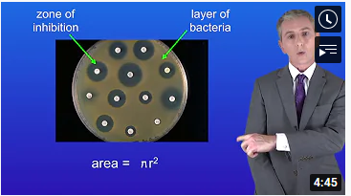
Triple only
GCSE Science Revision Biology "Required Practical 2: Culturing Microorganisms" (Triple) - YouTube

Slide 4
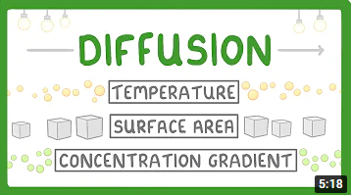
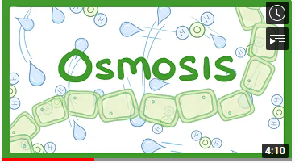
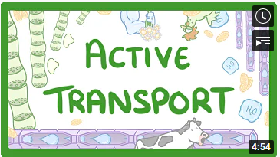
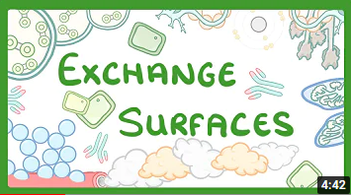
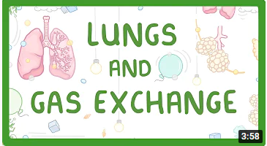
What is Diffusion? How Does it Work? What Factors Affect it? - YouTube
GCSE Biology - Osmosis #7 - YouTube
GCSE Science Revision Biology "Required Practical 3: Effects of Osmosis on Plant Tissue" - YouTube
GCSE Biology - Active Transport #8 - YouTube
gcse biology exchange surfaces - YouTube
GCSE Biology - Gas Exchange and Lungs #16 - YouTube

Slide 5
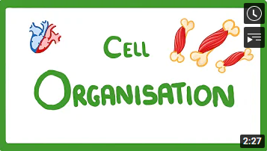
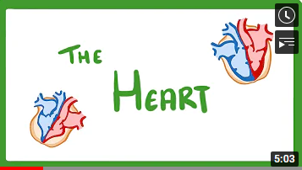
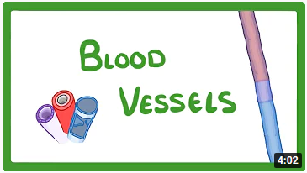
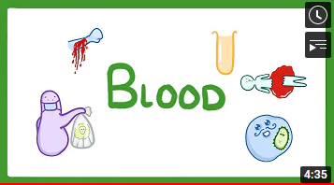
GCSE Biology - Levels of Organisation - Cells, Tissues, Organs and Organ Systems #10 - YouTube
GCSE Biology - The Heart #17 - YouTube
GCSE Biology - Gas Exchange and Lungs #16 - YouTube
GCSE Biology - Blood Vessels #18 - YouTube
GCSE Biology - What Is Blood Made of? / What Does Blood Do? #19 - YouTube

Slide 6
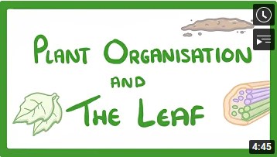
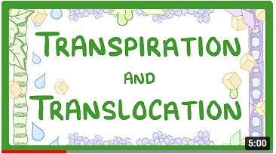
GCSE Biology - Structure of a Leaf and Stomata # 24 - YouTube
GCSE Biology - Transport in plants - Translocation (Phloem) and Transpiration (Xylem) #25 - YouTube

Slide 7
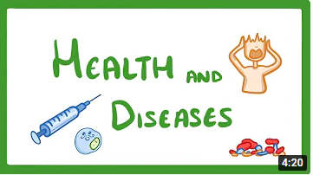
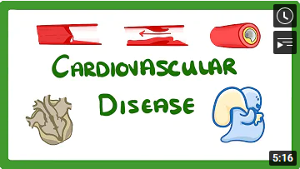
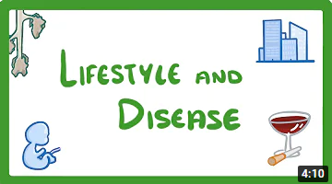
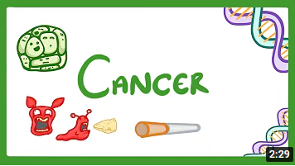
GCSE Biology - Health and Disease #21 - YouTube
GCSE Biology - Why Do We Get Heart Disease and How to Treat It? - Cardiovascular Disease (CVD) #20 - YouTube
GCSE Biology - Is Your Lifestyle Really a Personal Choice? - Lifestyle & Risk Factors #22 - YouTube
GCSE Biology - What is Cancer? 'Benign' and 'Malignant' Tumours Explained #23 - YouTube

Slide 8
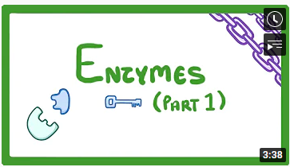
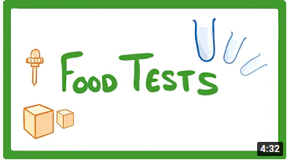
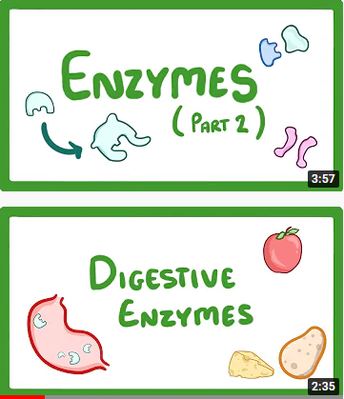
GCSE Biology - Food Tests Practicals #15 - YouTube
GCSE Biology - How Enzymes Work #11 - YouTube
GCSE Biology - Factors that Affect Enzymes #12 - YouTube
GCSE Biology - Digestive Enzymes #14 - YouTube

Slide 9
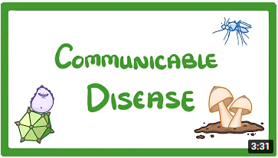
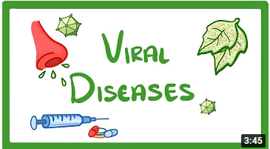
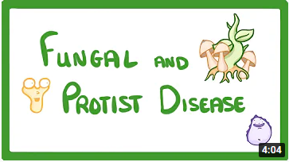
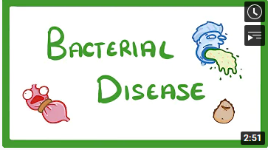
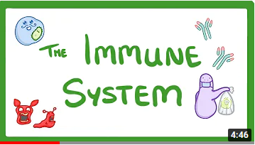
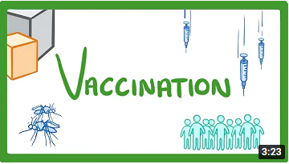
GCSE Biology - Communicable Disease #26 - YouTube
GCSE Biology - What Is a Virus? - Examples of Viral Disease (HIV, Measles & TMV) #27 - YouTube
GCSE Biology - How A Mushroom Can Kill You - Fungal and Protist Disease #29 - YouTube
GCSE Biology - What Are Bacterial Diseases? - Treatment and Prevention #28 - YouTube
GCSE Biology - Immune System (Defences Against Pathogens) #30 - YouTube
GCSE Biology - What Are Vaccines? Are They Safe? How Do They Work? Vaccines Explained #31 - YouTube

Slide 10
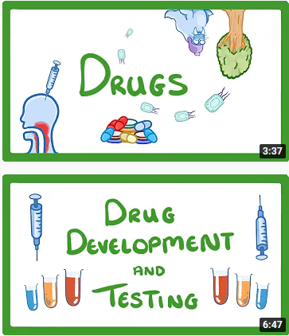
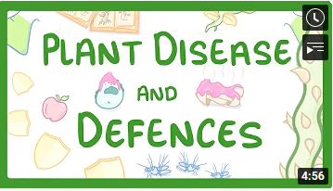
GCSE Biology - Drugs - Painkillers vs Antibiotics - Relief vs Treatment #32 - YouTube
GCSE Biology - Drug Development and Testing - Clinical Trials #33 - YouTube
GCSE Biology - Plant Disease and Defences #69 - YouTube

Slide 11
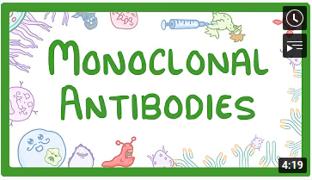
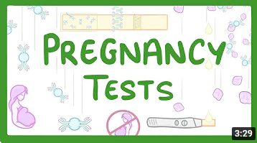
Triple
GCSE Biology - Monoclonal Antibodies #67 - YouTube
GCSE Biology - How do Pregnancy Tests Work? #68 - YouTube

Slide 12
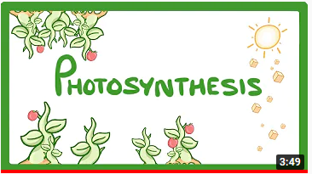
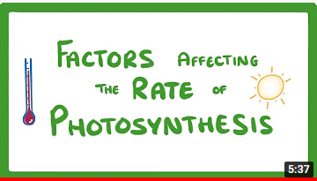
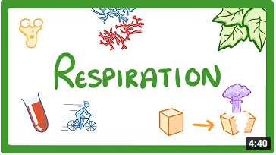
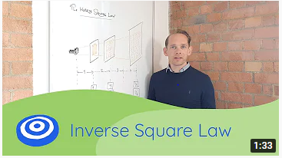
GCSE Biology - Photosynthesis #34 - YouTube
GCSE Biology - Factors Affecting the Rate of Photosynthesis #35 - YouTube
GCSE Biology - Respiration #36 - YouTube
Inverse Square Law - GCSE science, Biology (9-1) - YouTube

Slide 13
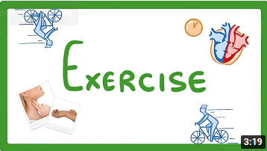
GCSE Biology - Exercise & Oxygen Debt #37 - YouTube
GCSE Science Revision Biology "Metabolism" - YouTube

